Slide 1


Loan Default Prediction Using Random Forest and Gradient‑Boosted Trees
course MACHINE LEARNING — BTech (Academic Year 2026‑27)
By Chegireddy Thanvi - Roll: 2520030214
K Rishitha - Roll: 2520030202
Guide: Shaik Asif
Department : Computer Science & Engineering
Notes:
1

Slide 2

Problem Statement
Loan default is a major challenge for banks and financial institutions because failure to identify high-risk borrowers can lead to financial losses.
The objective of our project is to develop a machine-learning-based loan default prediction system that analyzes borrower and loan-related information and predicts whether a borrower is likely to default or repay the loan.
The model will help identify important factors associated with loan default and support more data-driven credit-risk assessment
Notes:
2

Slide 3


Proposed Solution
We propose a machine-learning-based system that uses historical borrower and loan data to predict the possibility of loan default. The system analyses factors such as income, credit score, loan amount, employment status, interest rate, and debt-to-income ratio to identify patterns related to loan repayment.
We use Random Forest and Gradient-Boosted Trees to classify borrowers into two categories: likely to default or likely to repay. The performance of both models is evaluated and compared using suitable evaluation metrics.
The proposed system can help financial institutions identify high-risk borrowers at an early stage, improve credit-risk assessment, make more informed lending decisions, and reduce potential financial losses.
Notes:
3

Slide 4

Objectives
To predict whether a person will repay a loan or default.
To study borrower details like income, credit score, loan amount, and employment.
To use Random Forest to predict loan defaults.
To use Gradient-Boosted Trees to make another prediction.
To compare both models and find which one gives better results.
To help banks identify risky borrowers and make better loan decisions.
Notes:
4

Slide 5
Dataset Overview
Dataset: Loan Default Prediction Dataset
Source: Kaggle
Records: 255,347
Features: 18 columns
Target: Default
0: No Default
1: Default
Contains borrower and loan-related information
Includes details like income, credit score, loan amount, interest rate, employment, and DTI ratio
Used to predict loan default using Machine Learning
Project Use:
The dataset is used to train and compare Random Forest and Gradient-Boosted Trees models.
Notes:
4

Slide 6
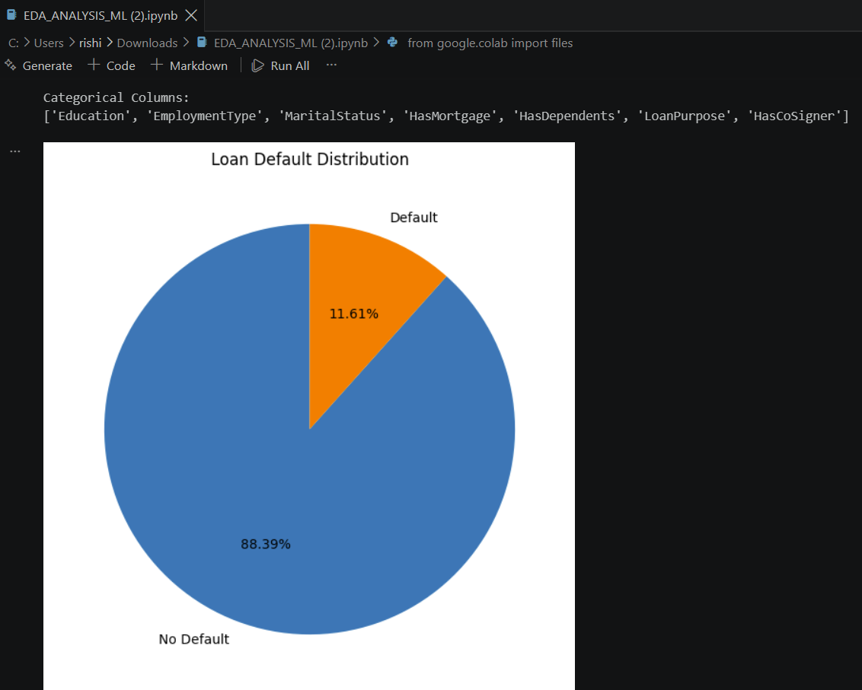
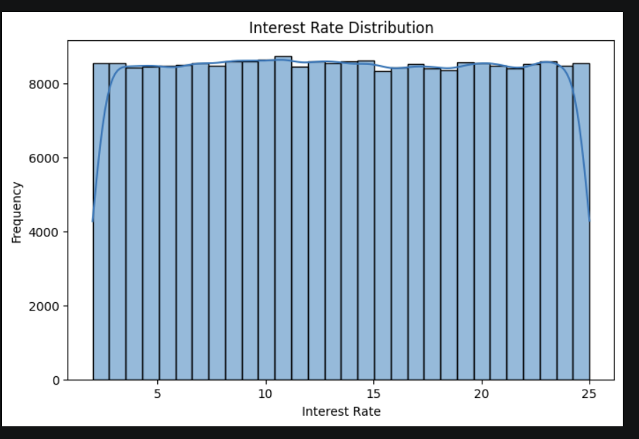

Exploratory Data Analysis(EDA)
Notes:
6

Slide 7
EDA Findings:
The dataset contains 255,347 loan records and 18 columns.
There are no missing values in the dataset.
There are no duplicate records.
The dataset contains both numerical and categorical features.
The target variable is Default, where 0 = No Default and 1 = Default.
Unemployed borrowers have the highest default rate (13.55%) among employment types.
Full-time employees have the lowest default rate (9.46%).
Default rate is generally higher for borrowers with lower credit scores.
The 300–499 credit score group has the highest default rate (12.77%).
The 800–849 credit score group has the lowest default rate (9.81%).
Default rates vary across different loan purposes, with Business loans having the highest rate (12.33%) and Home loans the lowest (10.23%).
Numerical features such as income, loan amount, credit score, interest rate, and DTI ratio were analysed to understand their relationship with loan default.
Notes:
7

Slide 8

Modules, Objectives & Expected Outcomes
1
2
3
4
Module 1 — Data Acquisition & Exploration
Module 2 — Preprocessing & Feature Engineering
Module 3 — Model Development
Module 4 — Evaluation & Explainability
Objective: Train Random Forest and Gradient‑Boosted models with hyperparameter tuning.
Outcome: Trained models with cross‑validated performance metrics.
Objective: Evaluate generalization, calibrate thresholds, and explain predictions.
Outcome: Confusion matrices, ROC‑AUC, SHAP explanations, and decision thresholds.
Objective: Collect and understand data distributions, missingness, and class balance.
Outcome: Cleaned dataset and exploratory report with visual summaries.
Objective: Impute, encode, scale, and create informative features.
Outcome: Production‑ready feature set and transformation pipeline.
5
Module 5 — Prototype & Reporting
Objective: Build a simple scoring API and prepare final report with signature block.
Outcome: Prototype app (Flask/Streamlit), documentation, and signed project report.
Notes:
9

Slide 9

Research papers
  file:///C:/Users/thanv/Downloads/qiu2019.pdf
  file:///C:/Users/thanv/Downloads/shaheen2018.pdf
Notes:
8

Slide 10
Conclusions, Limitations & Next Steps
Ensemble tree models (especially gradient boosting) reliably identify high‑risk borrowers when paired with careful preprocessing and explainability tools.
The approach supports safer lending decisions and risk mitigation.
Limitations:
Model performance depends on data quality and representativeness. Potential biases (e.g., socio‑economic proxies) must be analyzed and mitigated to meet fairness and regulatory requirements.
  Conduct fairness audits and bias mitigation (adversarial debiasing, reweighing).
  Integrate cost‑sensitive learning to align predictions with financial impact.
  Deploy an explainable scoring service with human‑in‑the‑loop review for flagged cases.
Notes:
10

